Slide 1
LE26-107 What's new: Enhanced demo data
Kennie Nybo Pontoppidan

Slide 2
Business Value
Allows partners to better demo analytics and reporting
Fixed assets, Sales, Purchasing, Subscription billing
Notes:
LE25-100

Slide 3
Enhanced Demo data (highlights)
Fixed Assets
Transactions
Sales
Open sales orders
Sales back orders
Purchasing
Purchase Return Orders
Subscription billing
Customer contracts
Vendor contracts
Transactions

Slide 4
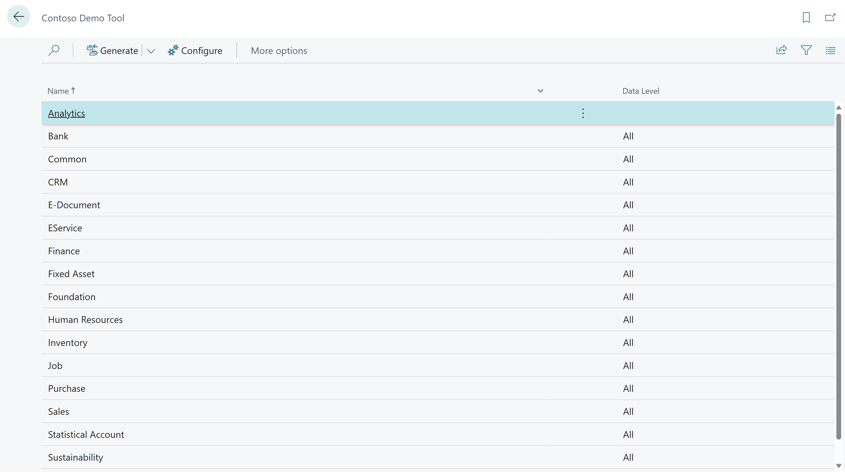

Slide 5
Enhanced demo data for Fixed Assets
Added transaction data (acquisitions and depreciations)
Allows for better demos on
Fixed Asset Details (Excel)
Fixed Asset Analysis (Excel)
Fixed Asset Projected Value (Excel)
Fixed Assets Ad-hoc Analysis (query)
Analysis mode on Fixed Asset Ledgers and FA Registers

Slide 6
Enhanced demo data for Sales/Purchasing
More document demo data.
Spreaded sales documents across more salespeople.
Added line discounts to posted sales invoices.
Added new purchasing department dimension and used that on purchase documents before posting.
Added purchasers to purchase documents.

Slide 7
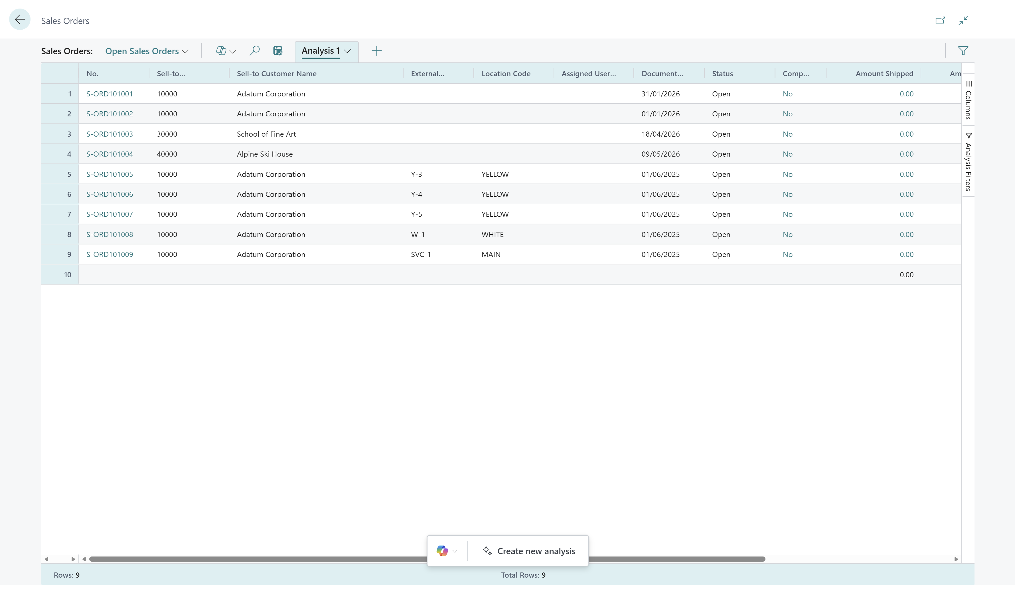
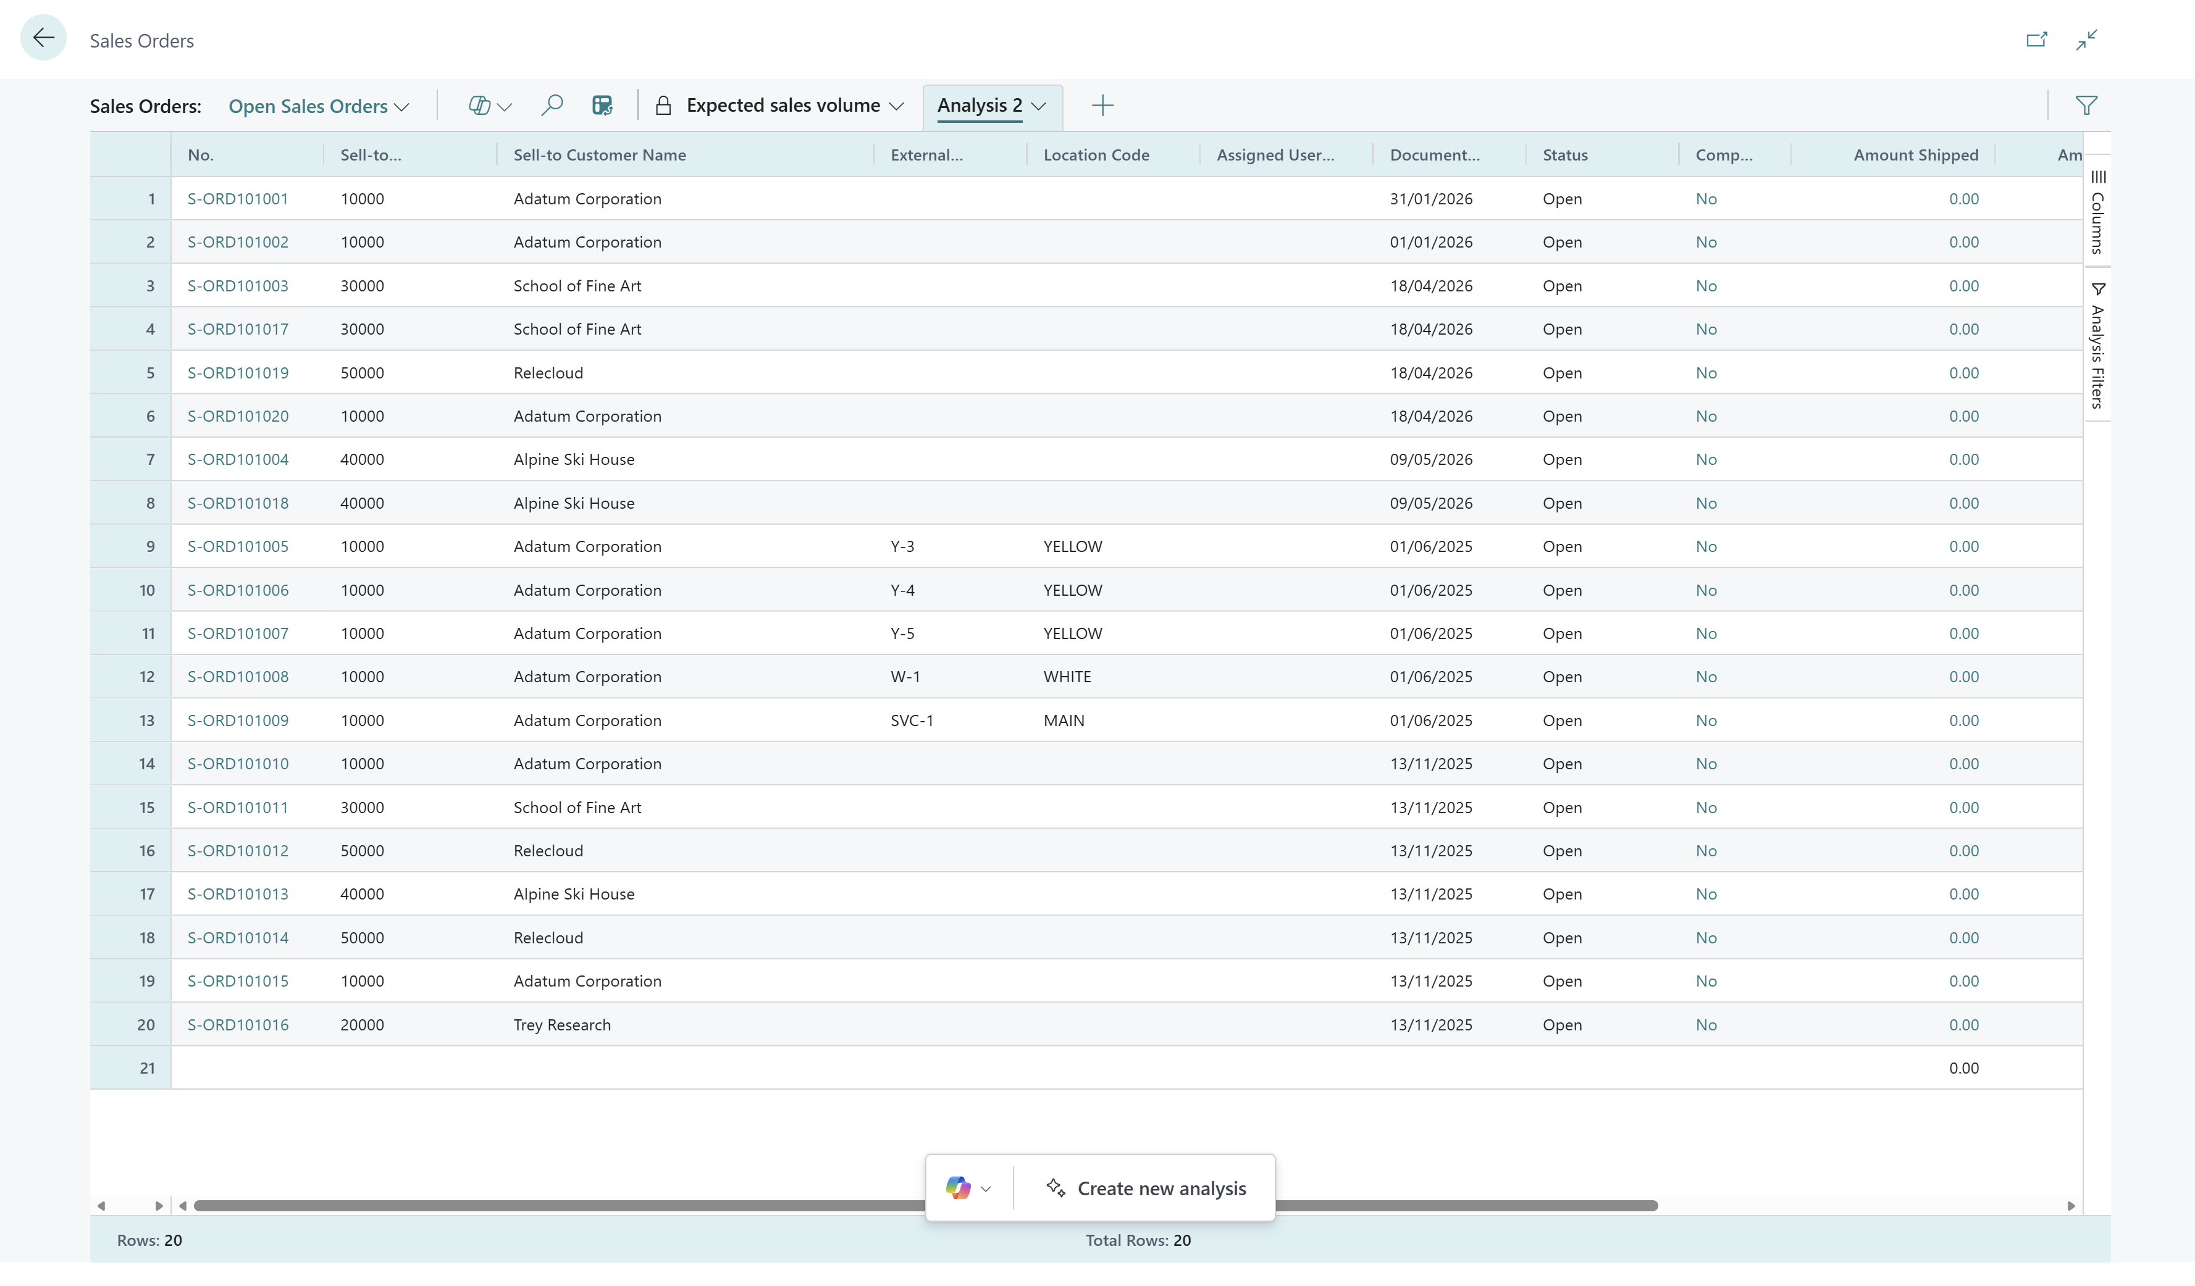
Open Sales Orders
Before (9)
Now (20)

Slide 8
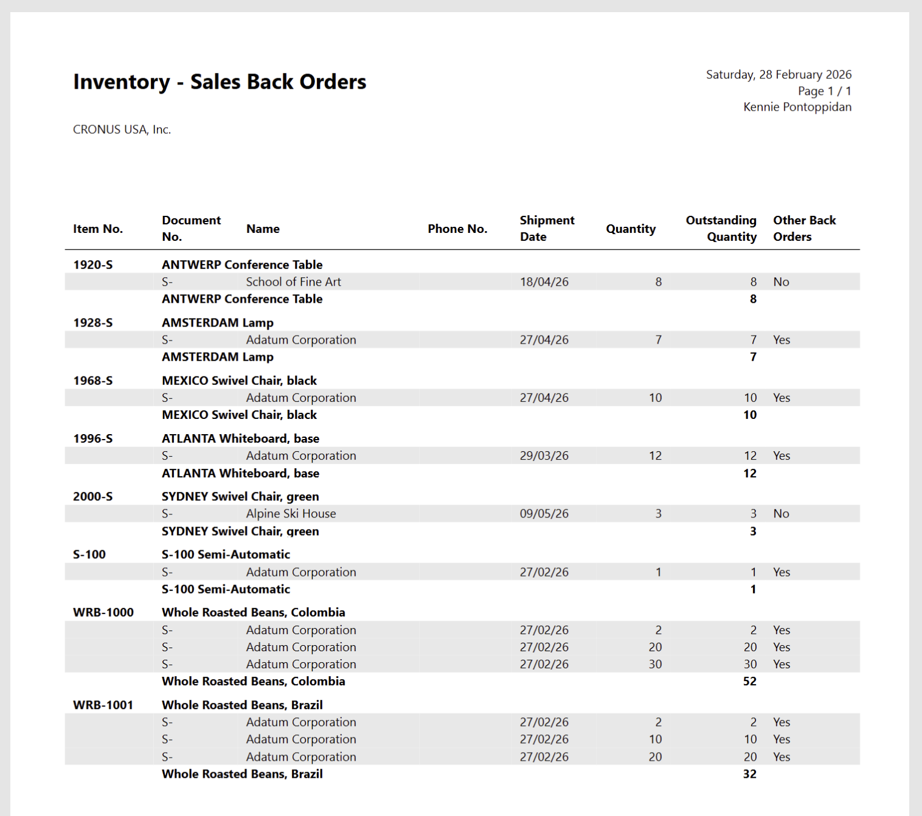
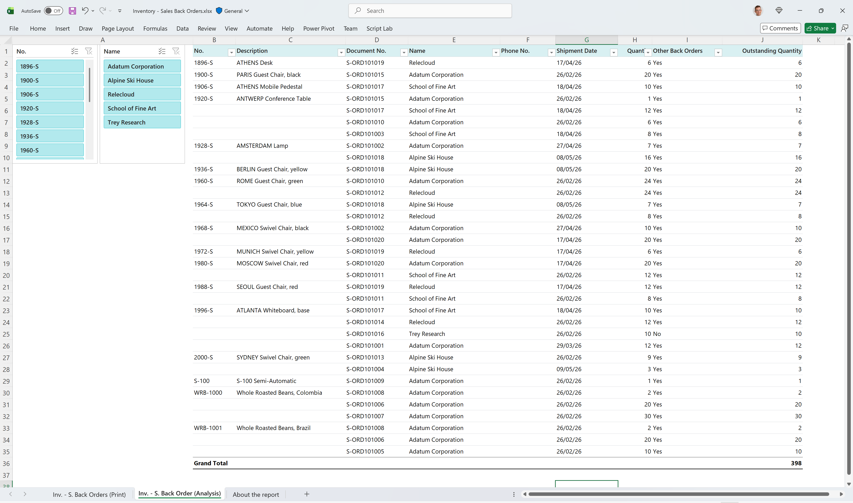
Sales Back Orders
Before (8)
Now (17)

Slide 9
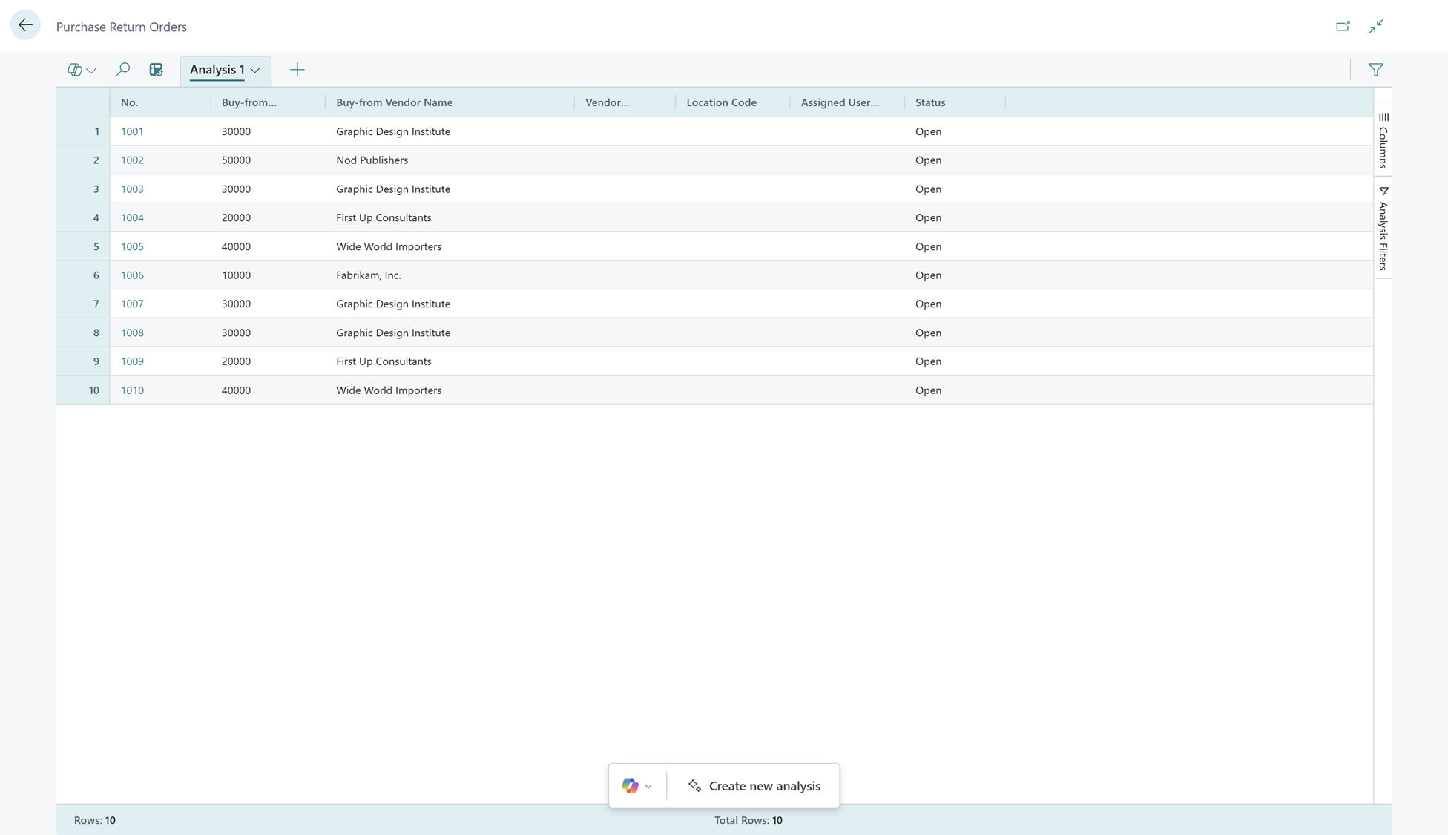
Purchase Return Orders
Before (0)
Now (10)

Slide 10
Enhanced demo data for Subscription Billing
More master data.
More transactions.

Slide 11
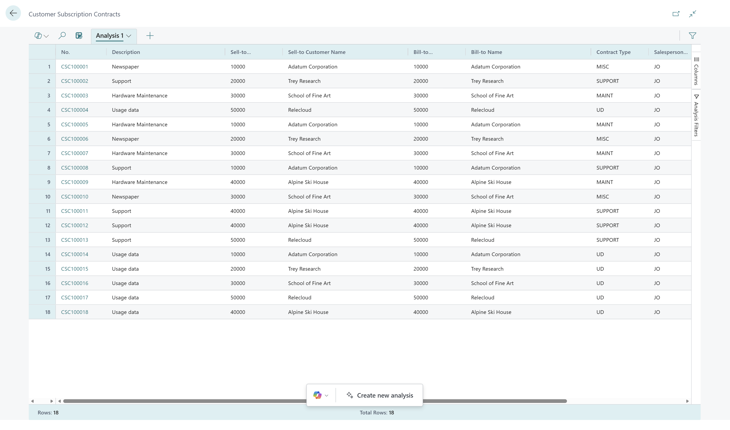
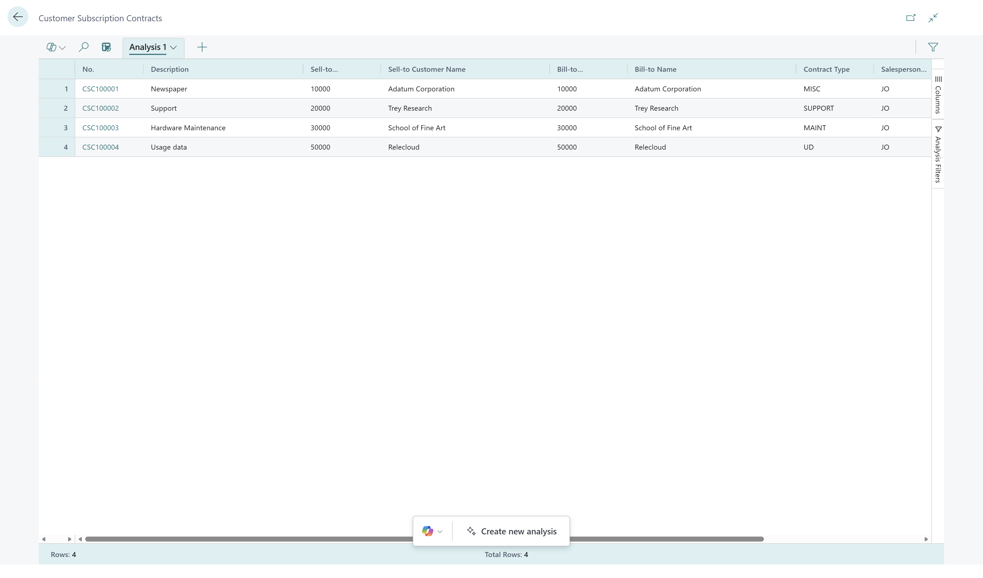
Subscription (billing) customer contracts
Before (4)
Now (18)

Slide 12
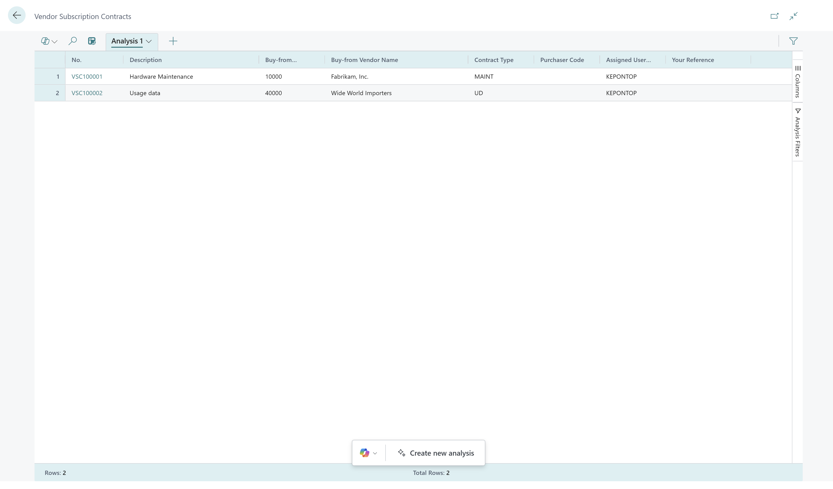
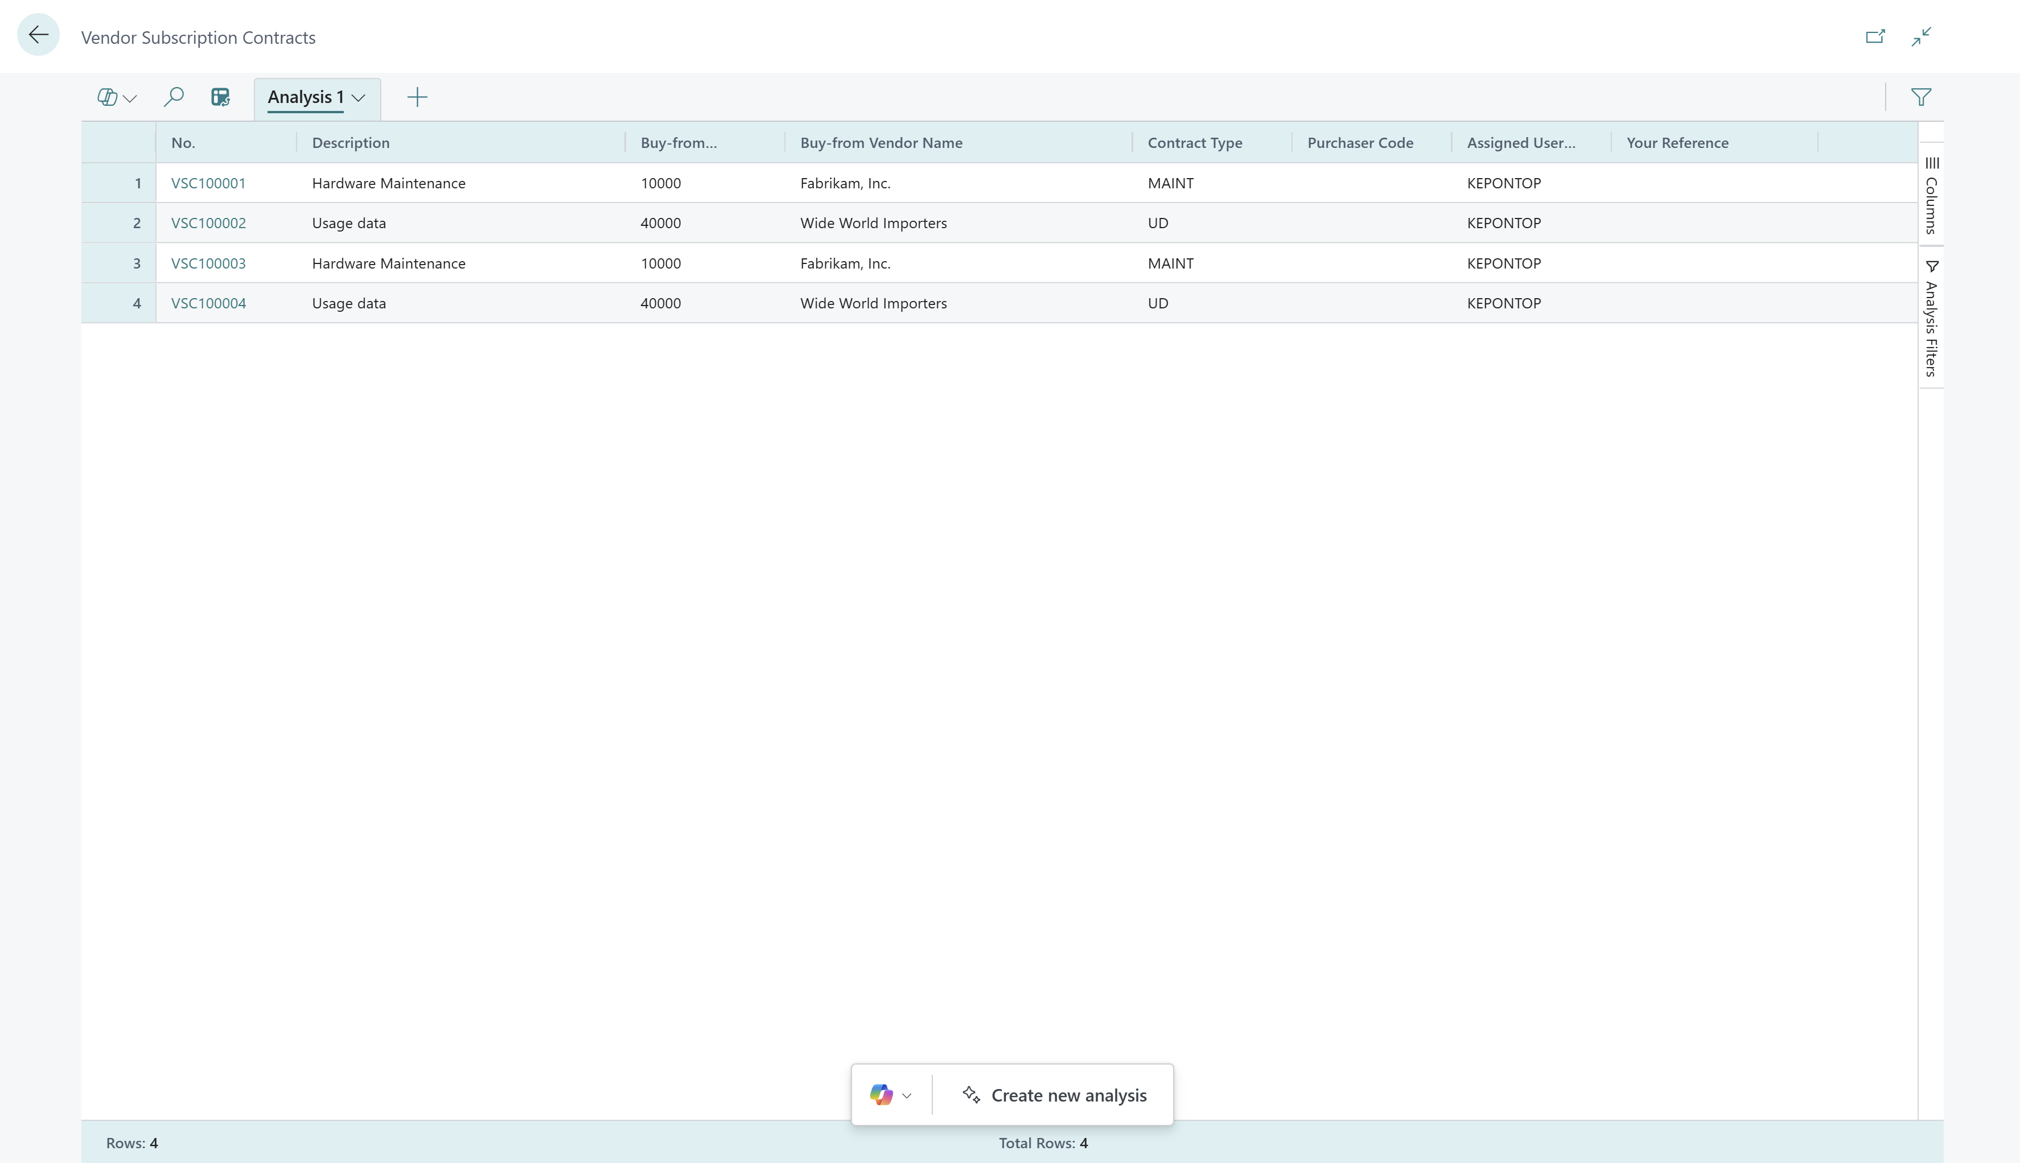
Subscription (billing) vendor contracts
Before (2)
Now (4)

Slide 13
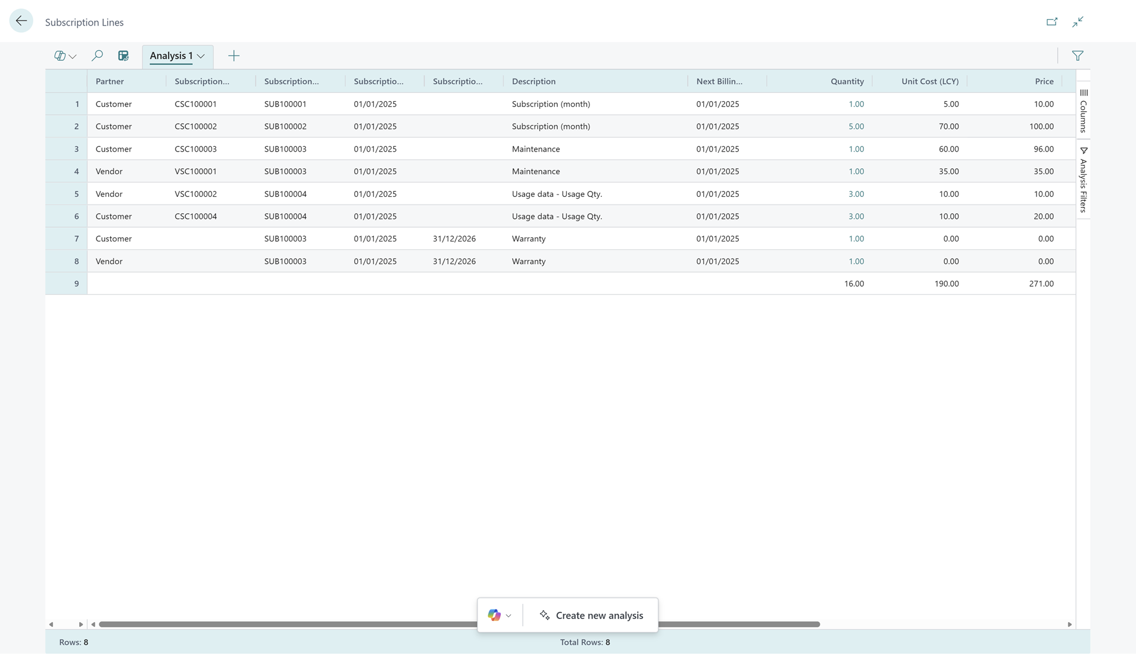
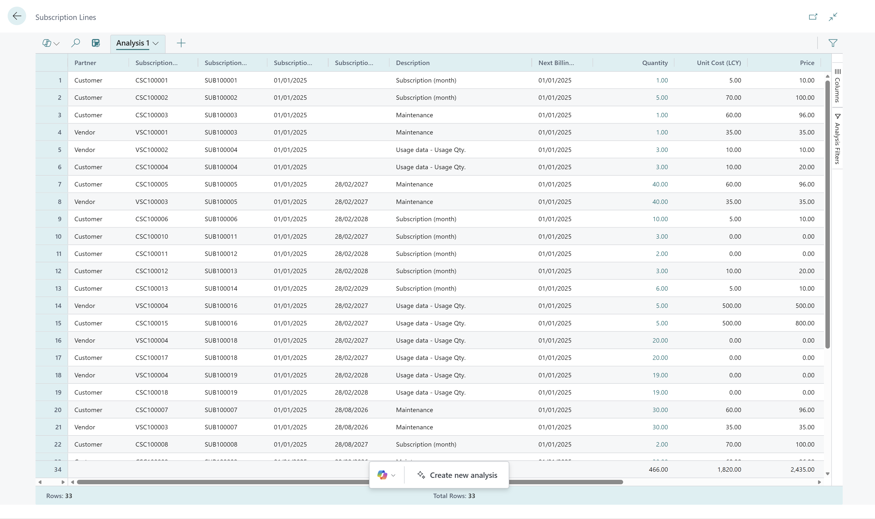
Subscription (billing) lines
Before (8)
Now (33)

Slide 14
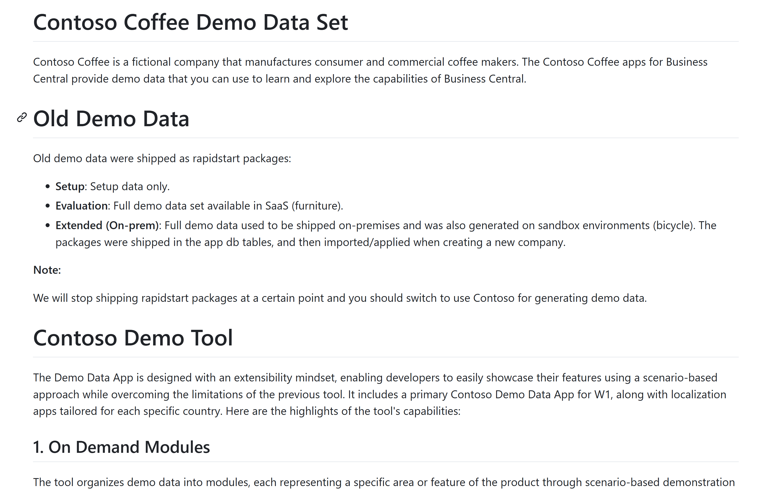
Want to learn more?
https://github.com/microsoft/ALAppExtensions/blob/main/Apps/W1/ContosoCoffeeDemoDataset/app/README.md

Slide 15
Related sessions
What's new: Enhanced sales analytics
What's new: Enhanced inventory analytics
What's new: Enhanced finance analytics
What's new: Enhanced Financial Reporting
What's new: Enhanced subscription billing analytics
What's new: Enhanced Power BI and Excel with Business Central
What's new: Enhanced Analysis Mode

Slide 16
General Business Central resources
Learn more!
Looking for resources?
Watch more on YouTube
aka.ms/BCAll
aka.ms/BCYouTube
Join Viva Engage to ask questions
Follow on LinkedIn
aka.ms/BCLinkedIn
aka.ms/BCVivaEngage
Join the office hours
Microsoft page for partners
aka.ms/BCOfficeHours
aka.ms/BCPartnerPortal

Slide 17



LinkedIn
Follow the weekly news and announcements
on the Microsoft Dynamics 365 Business Central page
aka.ms/BCLinkedIn

Slide 18

Watch more videos on YouTube
One-stop shop to watch Business Central videos:
  What is new
  Copilot and AI
  Short tips and tricks
  Technical deep dives
  Under the Hood podcast series
aka.ms/BCYouTube

Slide 19
THANK YOU

